Slide 1



#Spszurich
#crmsaturday
SharePoint + CRM Saturday Zurich 2017
Integrating with Azure
Marius Agur Pedersen / @crmviking

Slide 2
















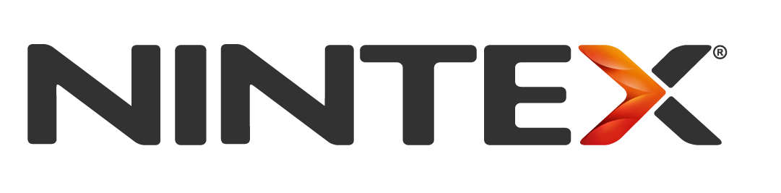

Slide 3
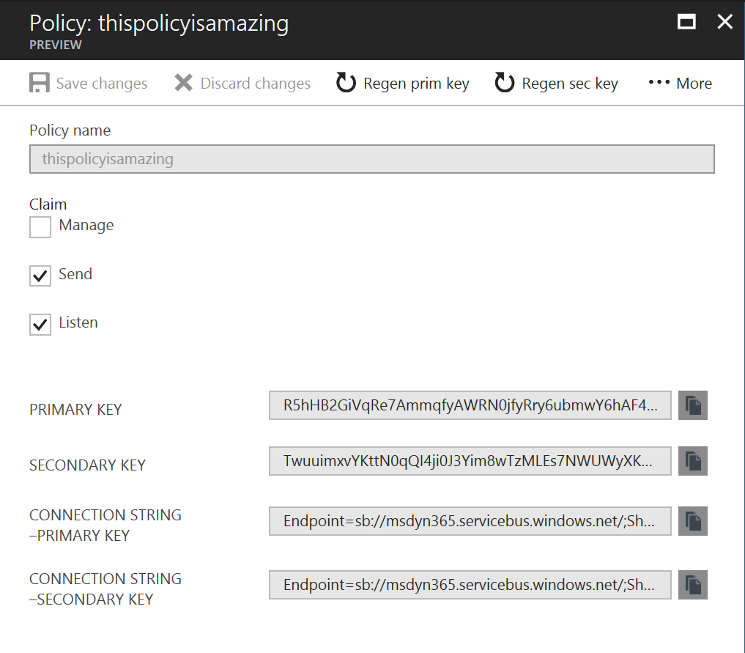
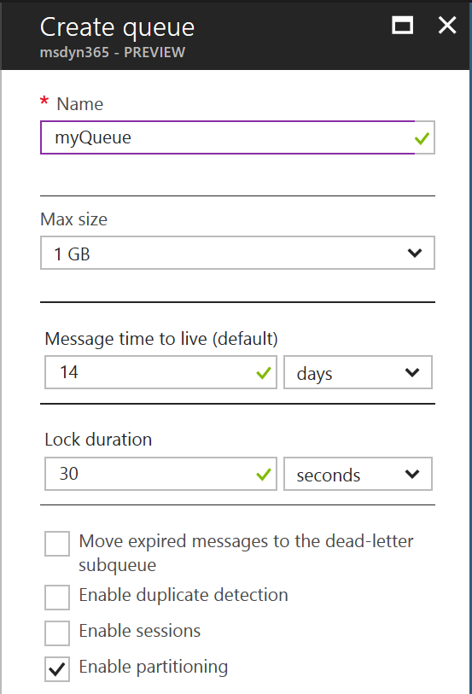
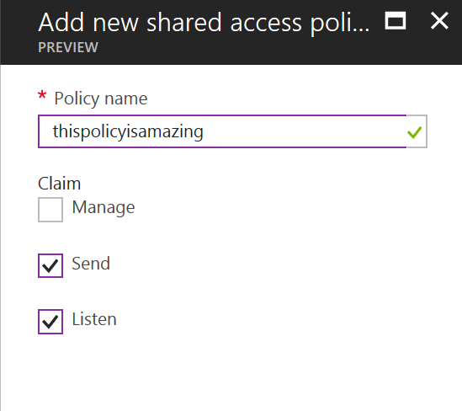
Creating resources in azure
Notes:
The Azure Service Bus is categorized as Internet of Things
Features:
Dead letter queue – Failed messages go here, can be configured to move expired messages as well
Duplicate detection – Configurable history length, 20 secs to 7 days
Sessions – Send several messages in a session, which allows a consumer to process related messages. No FIFO-functionality OOTB, must be configured manually
Partitioning – Distribute the load across multiple message brokers
Add shared access policy on a queue/topic or directly on the service bus (required for relay services)
Modifying an endpoint requires reentering of SAS key
ACS is discontinued and no longer supported with ASB
Topics works like queues, except that you create subscriptions that work across topics on a bus and can define filters

Slide 4
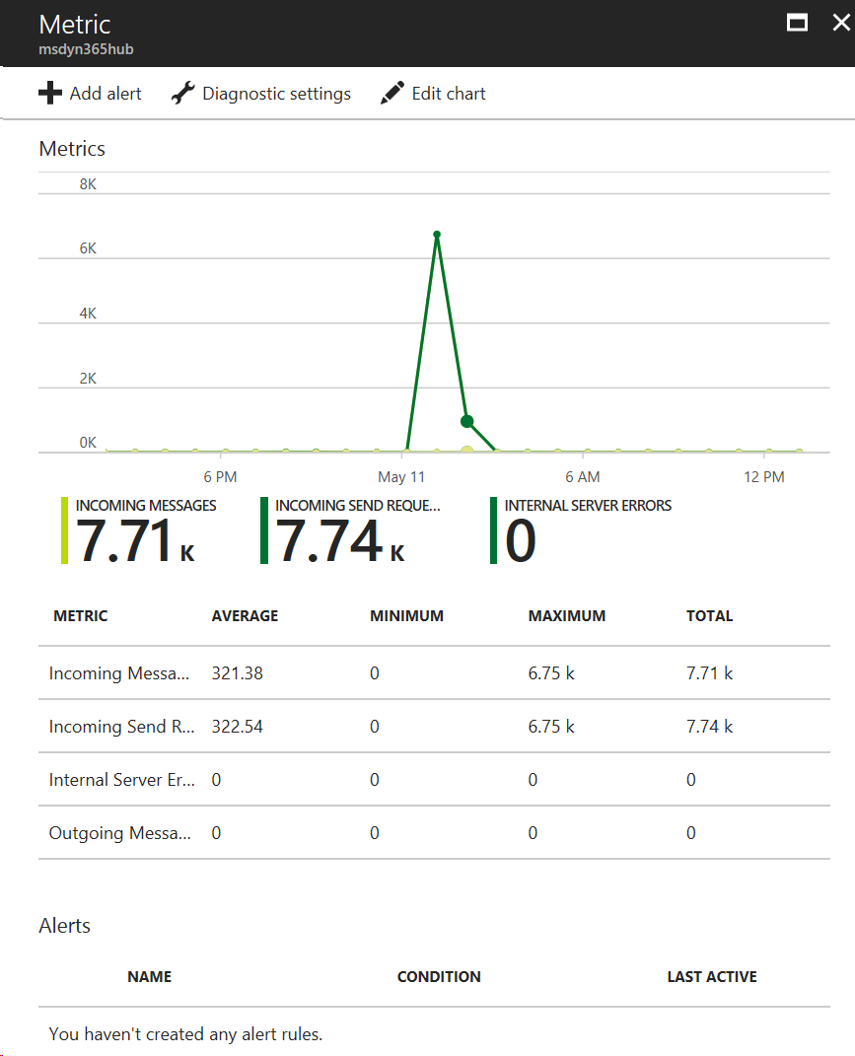
Azure event hubS
Notes:
Configured just like a queue/topic
Handles a lot of messages/second (estimated max capacity) 6 million/sec
Allows horizontal scaling by distributing messages across partitions
Data is not discarded, it is deleted after the retention time is hit
Works like a commit log, everything message is stored in the sequence they entered, for each partition
Partition keys are hashed and assigned to a partition

Slide 5
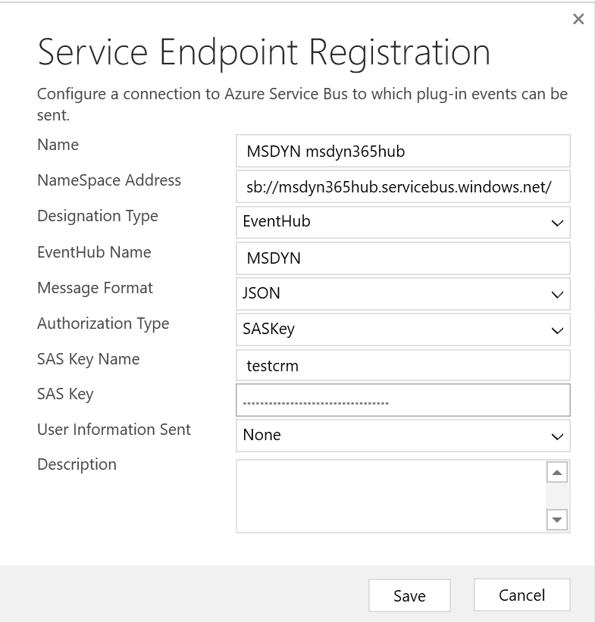
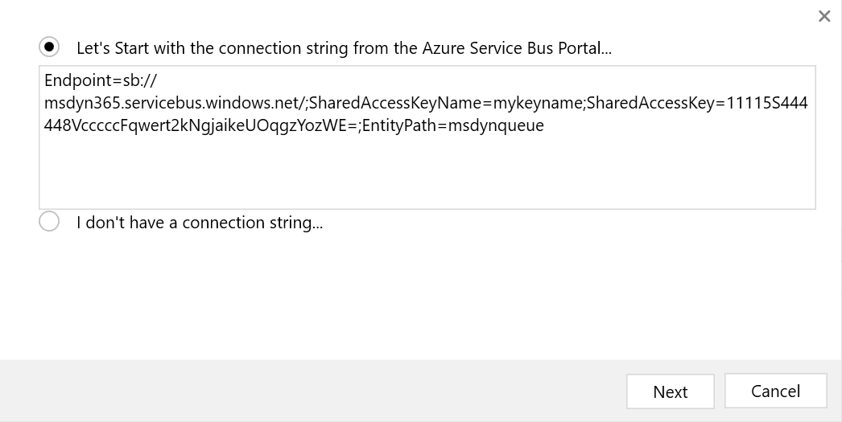
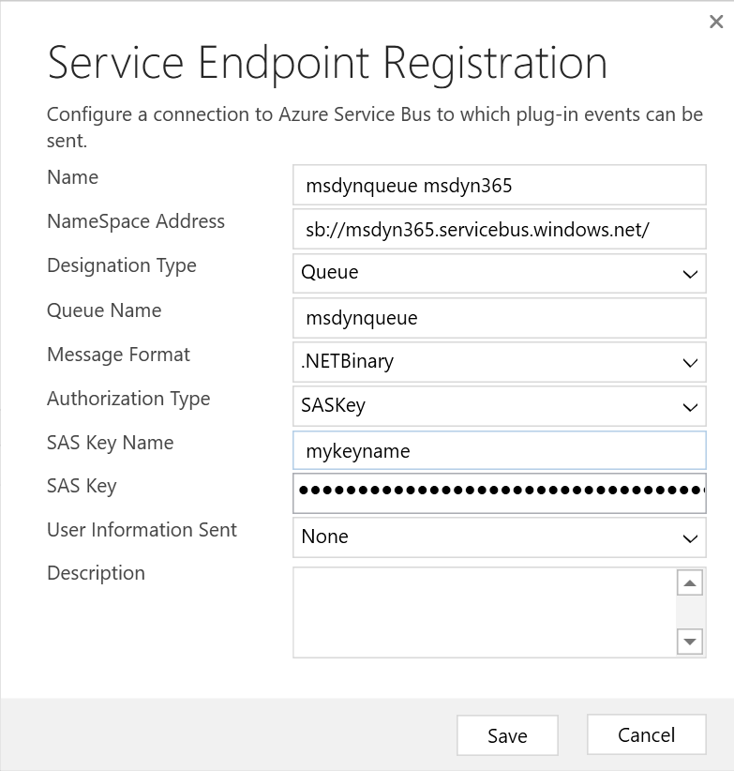
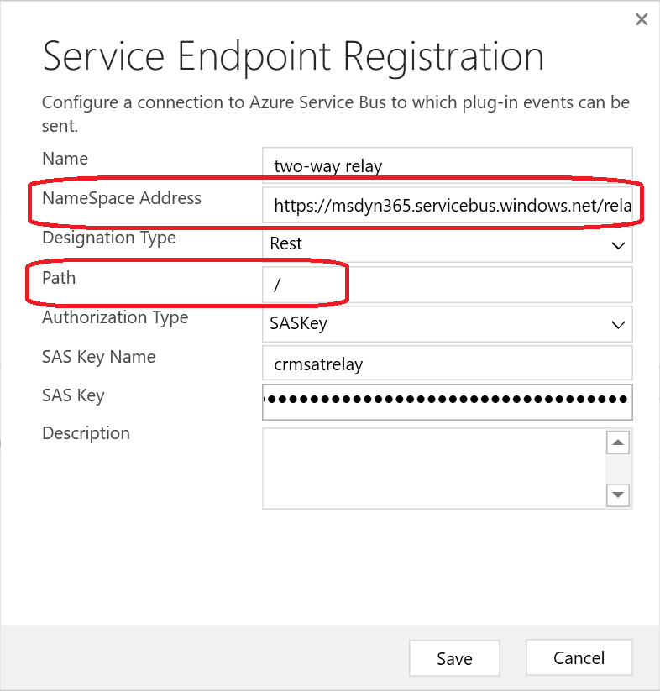
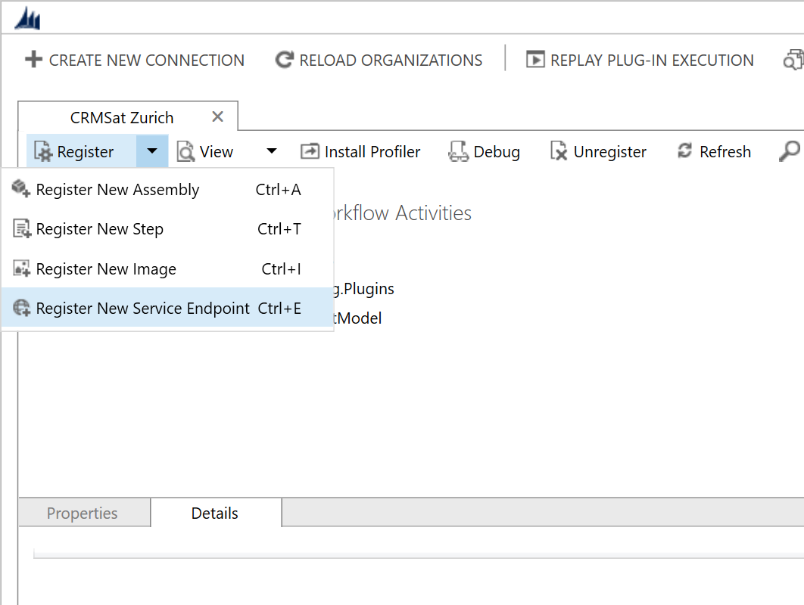
Register endpoint
Notes:
SAS is Shared Access Signature
SASKey is when you use a SAS key and signature to generate new tokens automatically in the background.
SASToken is when you use a pre-generated token, which is a hash of the URI and an expiration time signed with the key
Designation type is: queue, topic, one-way relay, two-way relay, REST Listener (REST based two-way relay), Event Hub
Queue and topic uses AMQP, relay services uses HTTPS. Event hub endpoint only supports AMQP, even though the event hub has support for both
Message limit is 256kB, even for event hub batch

Slide 6
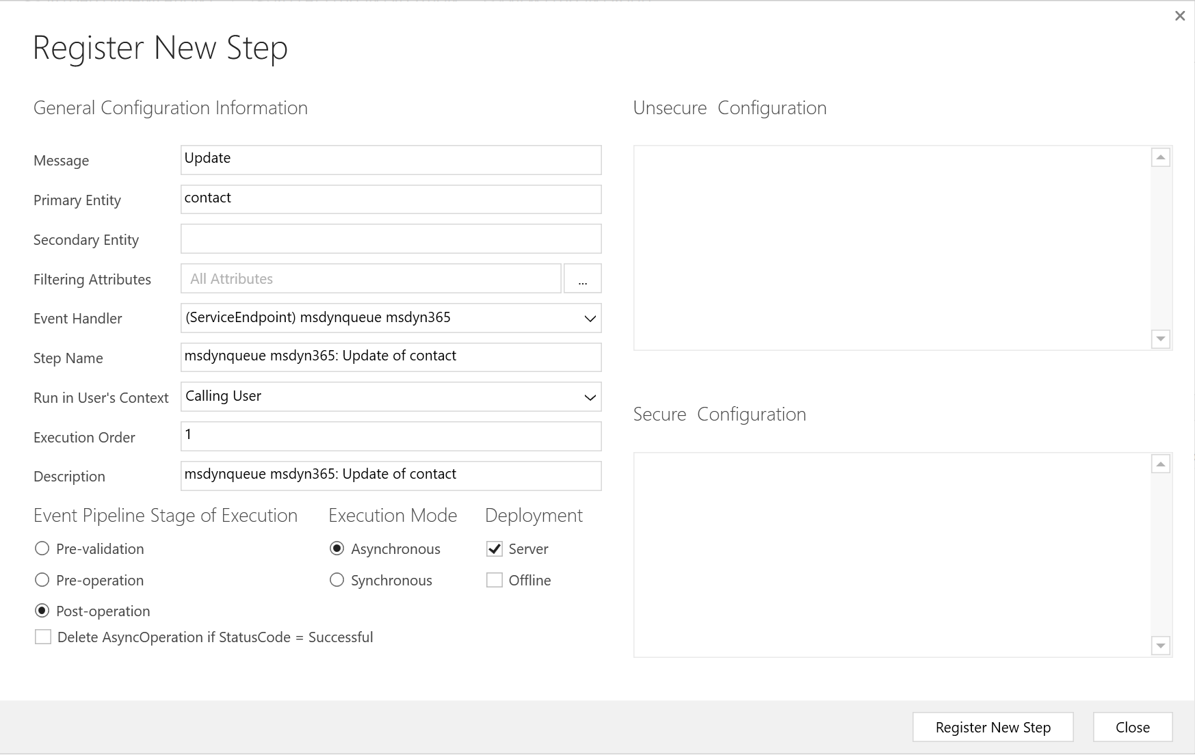
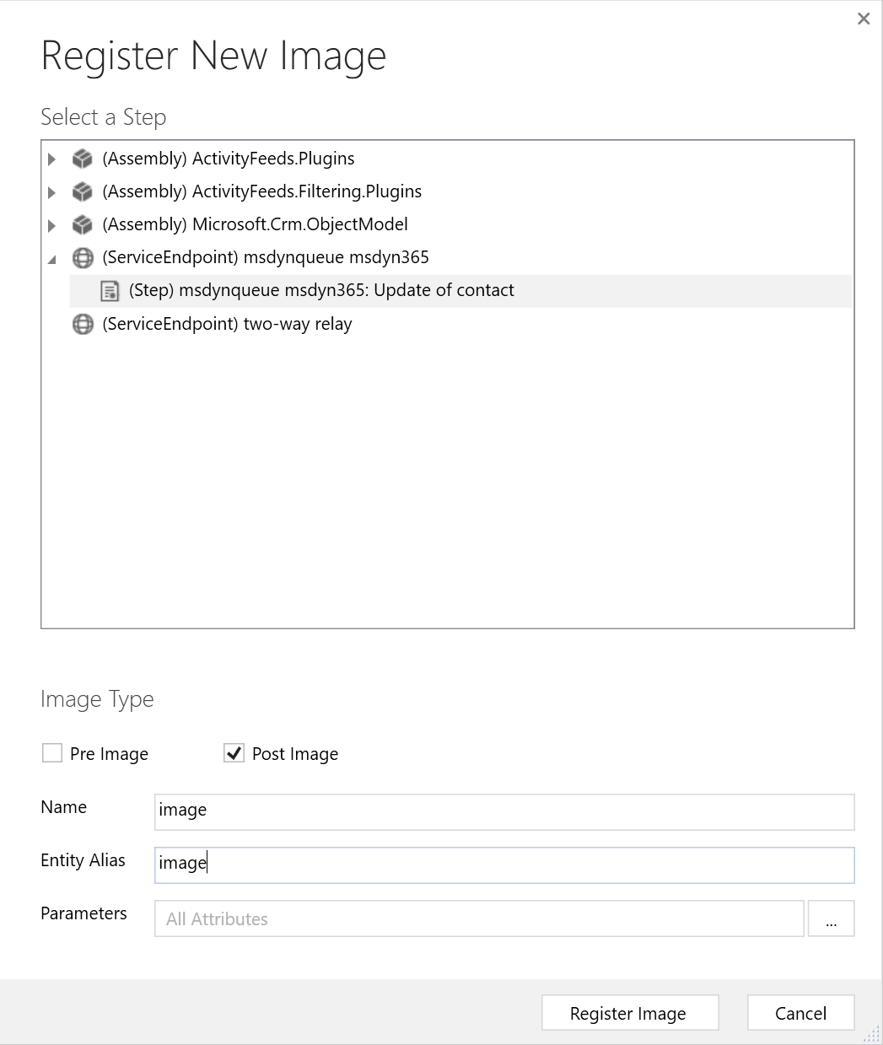
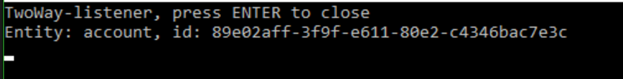
Adding steps and images to an endpoint

Slide 7
Using endpoints programmatically
TO VISUAL STUDIO!

Slide 8
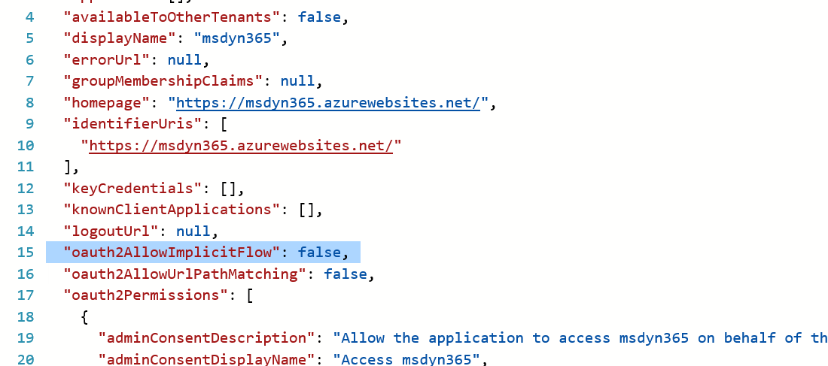
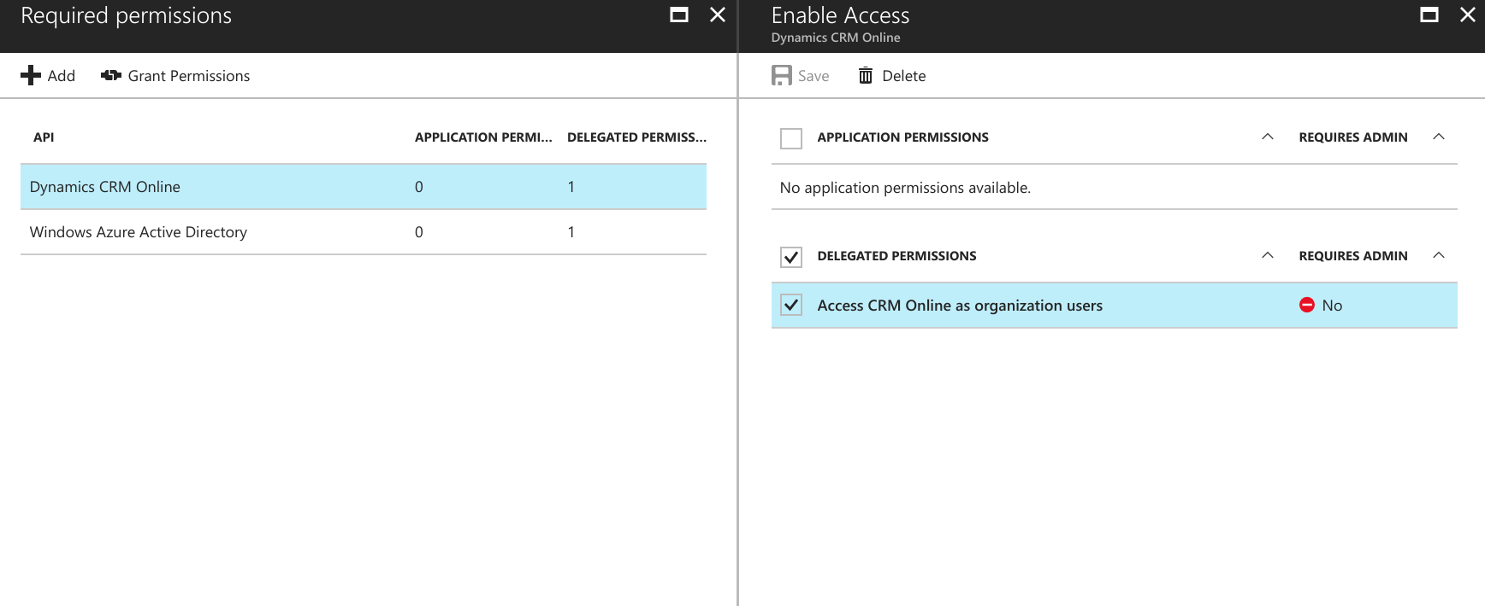
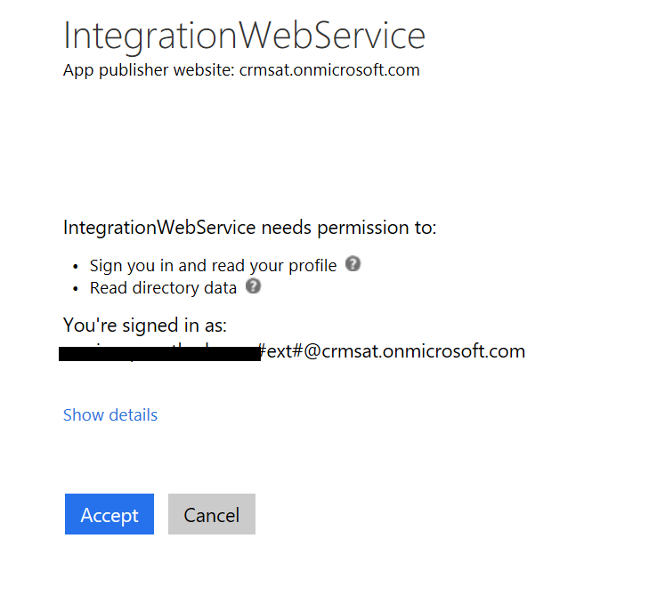
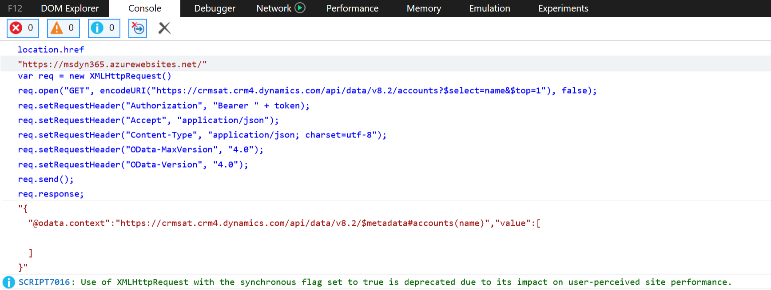
Adding service account and application permissions
Notes:
Register new application in azure ad, add new permission (CRM Online), grant permissions to update permissions.
Open app manifest and set implicit flow to enable token authentication and javascript calls to the api
Implicit flow with bearer token granted from azure web site
Walkthrough available here: https://msdn.microsoft.com/nb-no/library/mt595797.aspx
Multi-tenant support

Slide 9
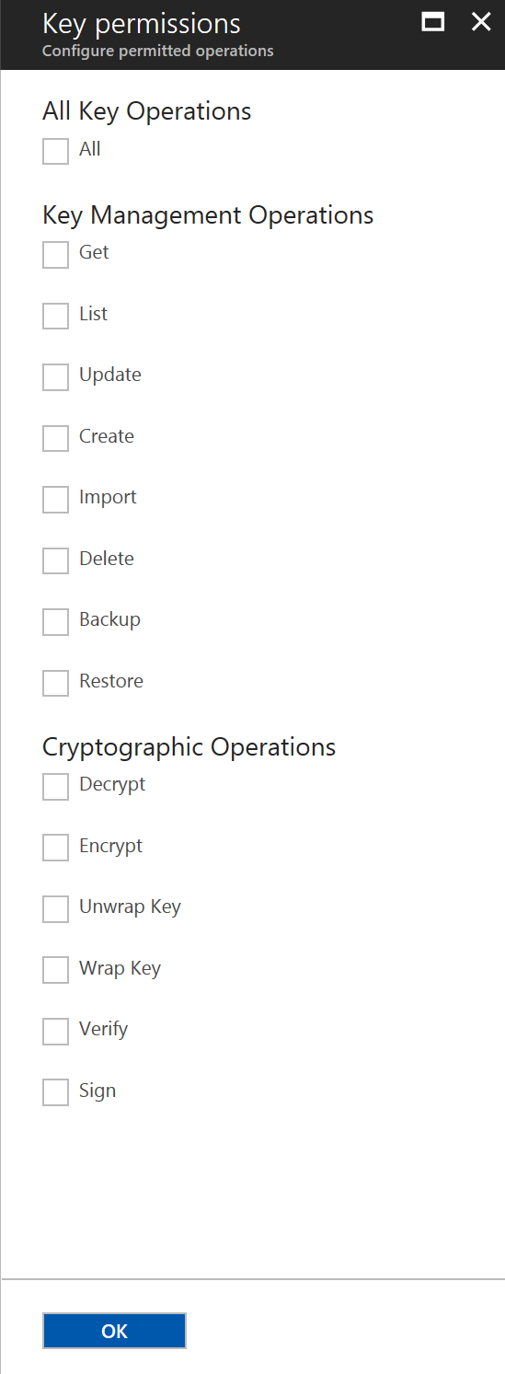
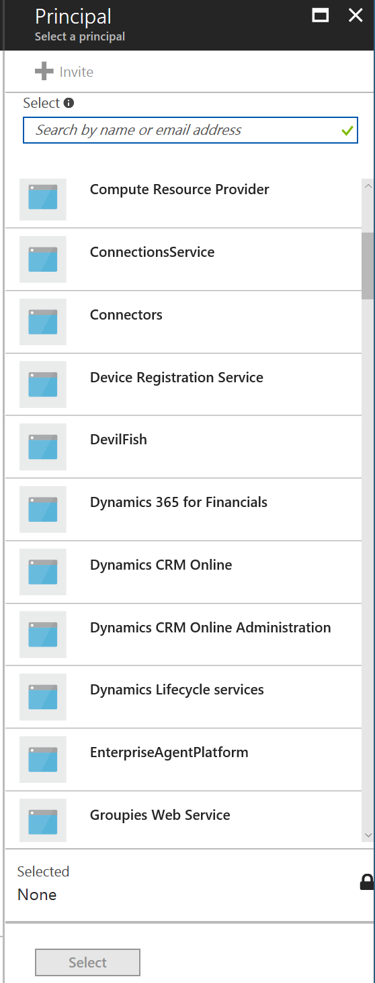
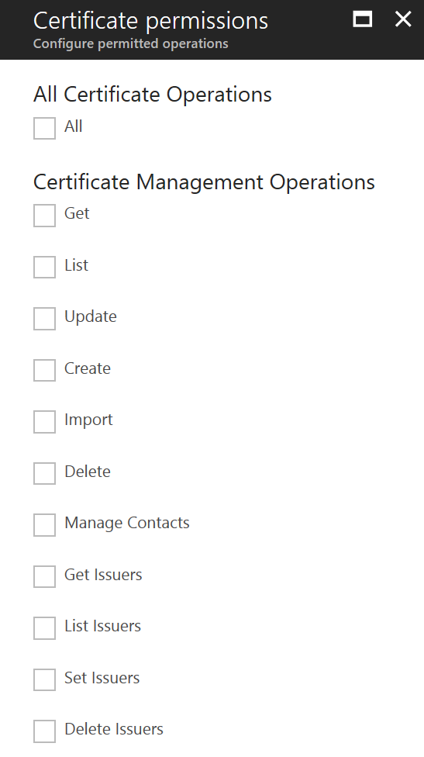
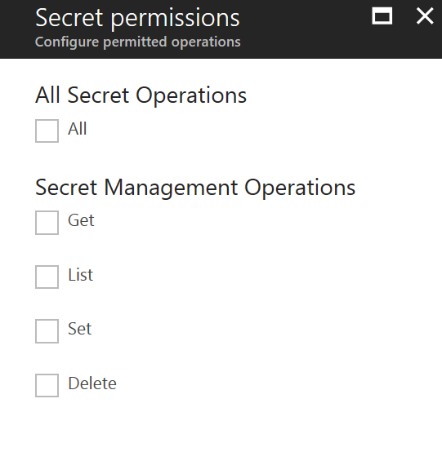
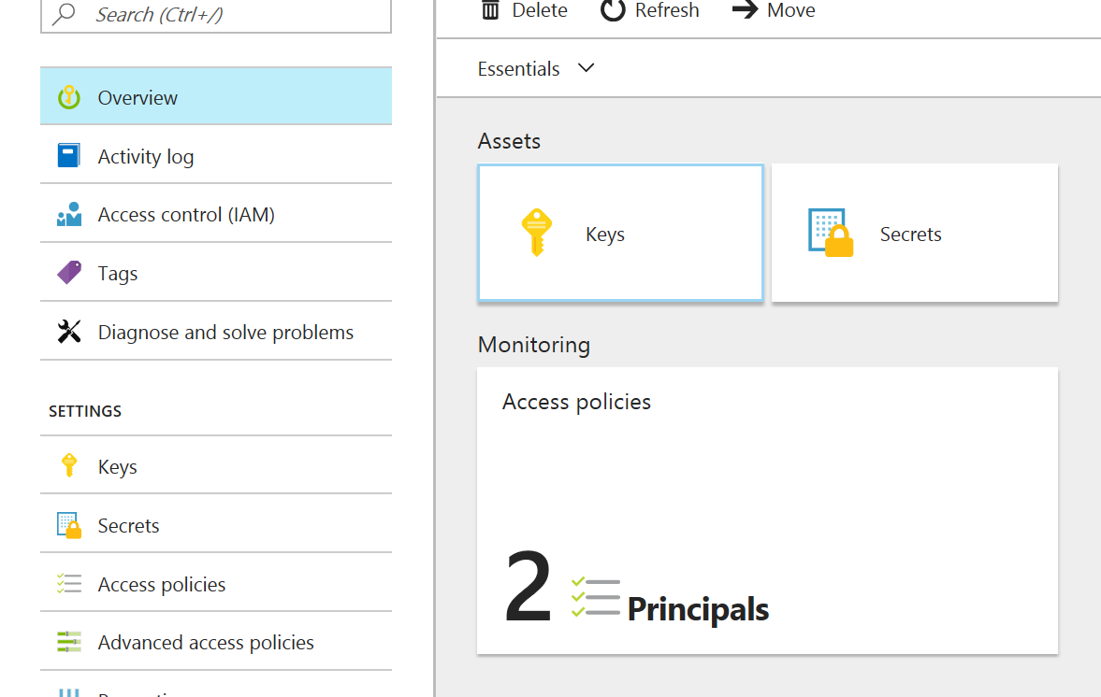
Azure Key vault
Notes:
Secure solution which lets you store and manage secrets and keys
Integration with several enterprise applications, enables storing encryption key directly from MSDYN to Azure Key Vault
Access is given to all records of the permitted type for one vault
Combine vaults to provide hash table-like configuration

Slide 10
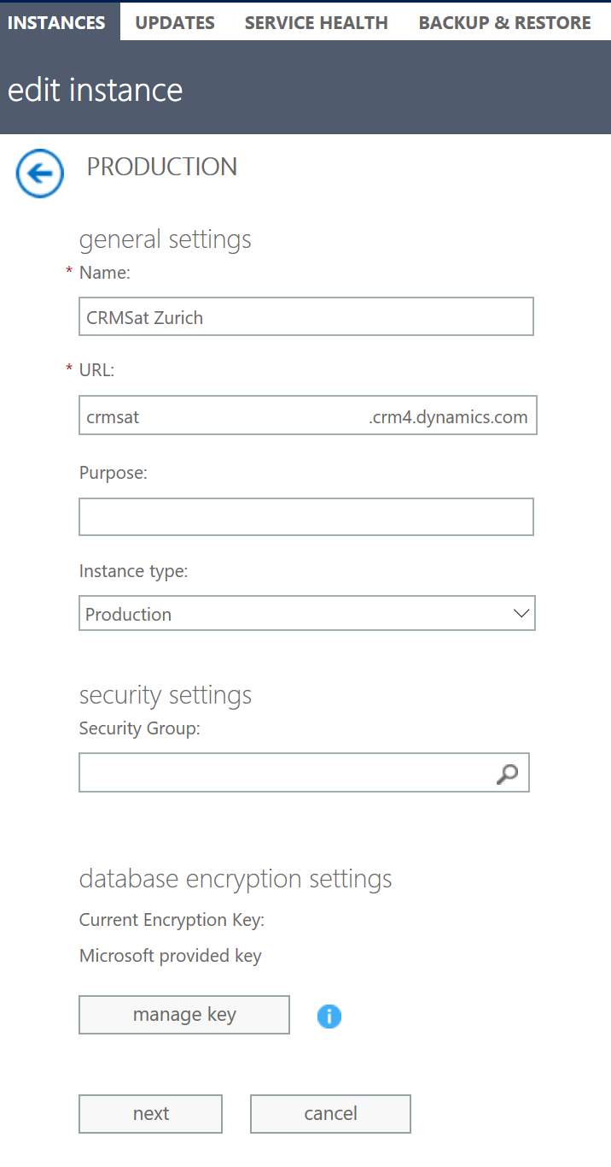
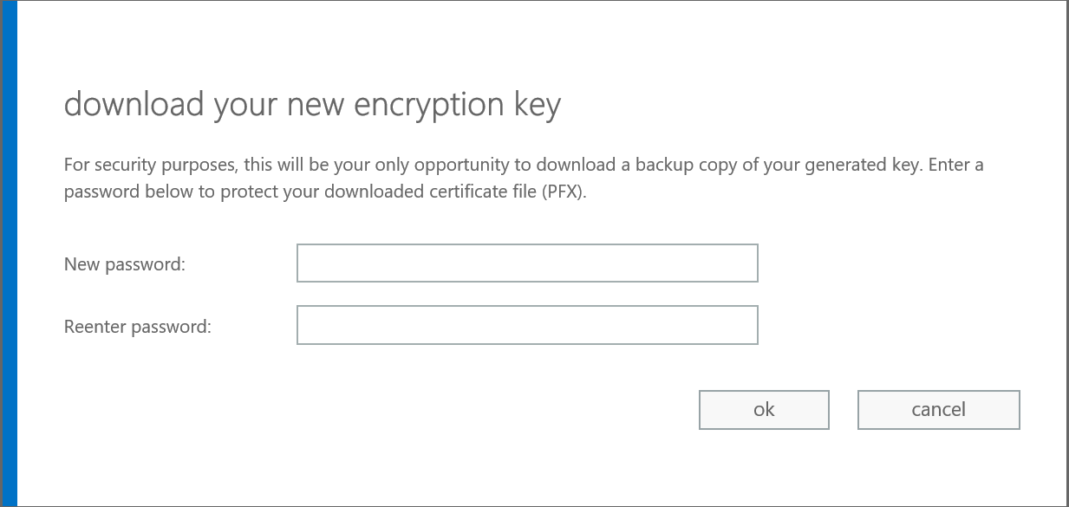
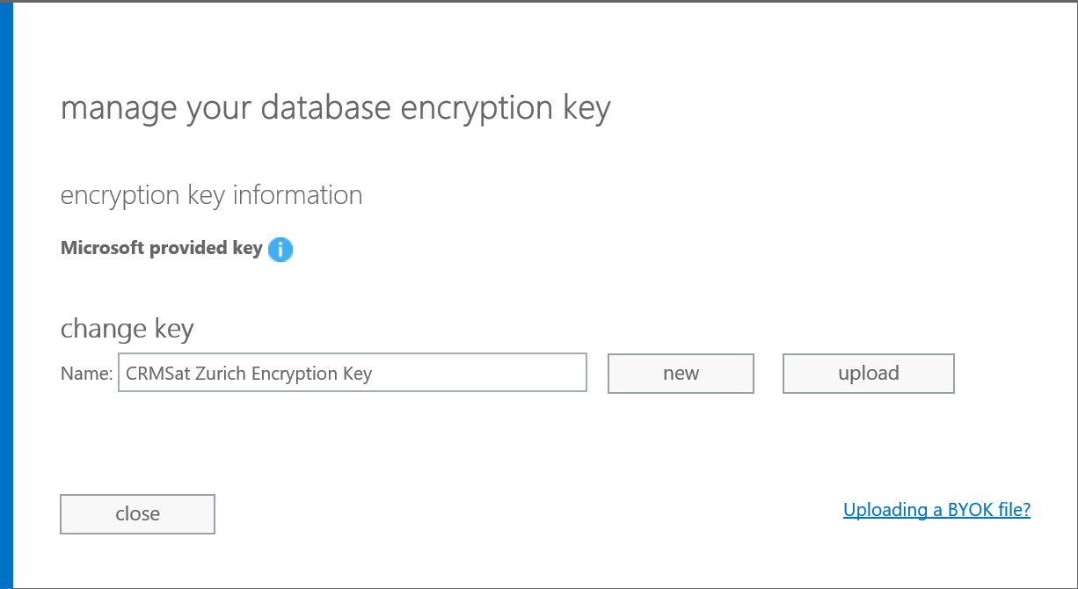
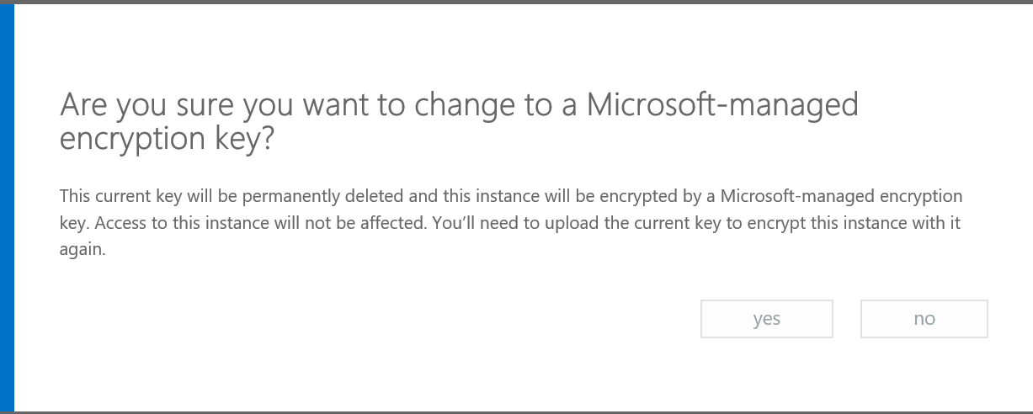
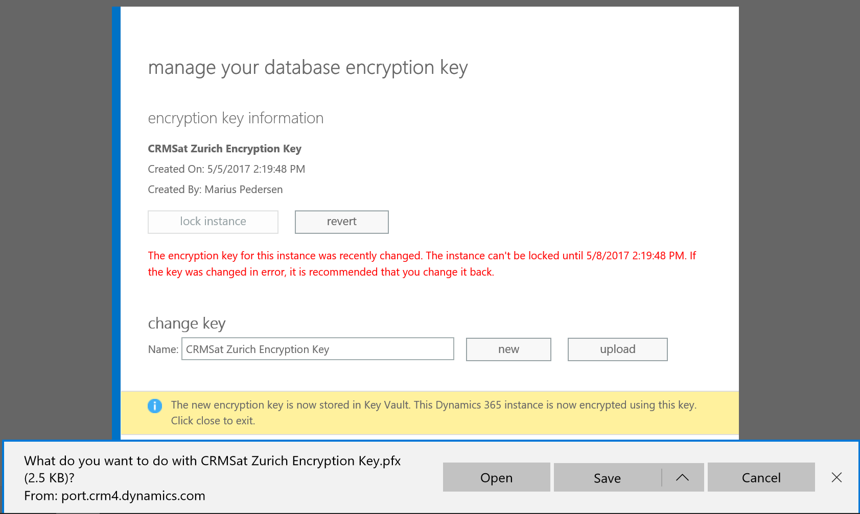
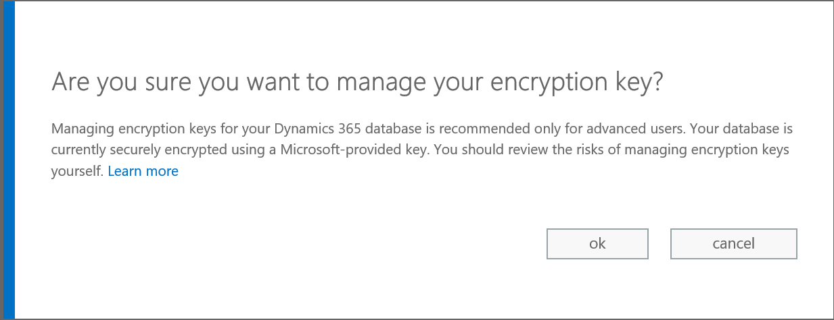
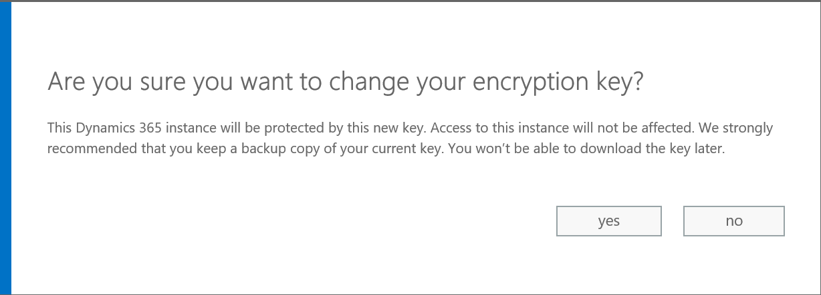
Manage encryption keys
Notes:
Usually not worth it, do you trust your admins more than you trust MS?
Gives a 72 hour warning on key change to all admins
Edit instance to get to key management. Available for o365 admins and MSDYN365 admins
Allows you to generate new key or upload your own key, supports both PFX (must be password protected) and HSMs (requires own hardware)
Tons of warnings, so you’re not doing this by accident
Warning when you revert to MS managed

Slide 11
Wrap up
Azure Service Bus (ASB) is the most effective way to do message based integration
Relaying lets you do real time operation on messages
Azure Event Hubs can receive a lot of requests, excellent analytics capabilities
Azure Web Sites is fast and secure, with custom domain/certificate capabilities
Azure Key Vault is a very cheap way to store and manage keys, certs and serets
Encryption keys for MSDYN365 can be stored in a custom Azure Key Vault
HSM available for particular cases

Slide 12

#CRMSATURDAY
#SPSZurich
@crmviking

